Slide 1
Enhanced Drowsiness Detection Using Machine Learning
Mohamed Nasrutheen.S
Morton Rillo.S
Naveen.A
Under the Guidance of
Ms.K.Thamizharasi M.E,
Assistant Professor.
12/04/2021

Slide 2
Overview of Project
Abstract
Existing System
Limitation of Existing System
Proposed System
Advantages of Proposed System
Data flow Diagram/Architectural diagram/Block diagram
Modules and Brief Description
Conclusions
References (IEEE format)
12/04/2021

Slide 3
Abstract
A recent study showed that around half a million accidents occur in a year, in India itself. Out of which 60% of these accidents are caused due to Driver Drowsiness.
Previous approaches are generally based on blink rate, eye closure, and other hand-engineered facial features.
The proposed algorithm makes use of features learned using a convolutional neural network to explicitly capture various latent facial features and the complex non-linear feature interactions.
This system is hence used for warning the driver of drowsiness by ringing alarm as well as to prevent traffic accidents by turning ON Parking lights and information shared to the registered mobile number via SMS, Phone Call.
12/04/2021
DATE

Slide 4
Existing System
Previous works have through the subsequent physiological signal to detect drowsiness: Graphical record ECG, myogram EMG, Electron-cephalogram EEG, and electrooculogram EOG.
Existing systems have used EOG signals to spot driver sleepiness through changes in eye movement.
The existing system will use the hand pressure sensor and eye blink rate to identify the driver’s drowsiness.
12/04/2021
DATE

Slide 5
Limitations of Existing System
The previous system requires an eye blinking rate and hand pressure sensor that will be 70 percent accurate.
The hand pressure sensor will show a false result when the driver also feels angry or high in an emotional state.
The face detection accuracy in the previous system will be less accurate than the proposed system.
12/04/2021
DATE

Slide 6
Literature Survey
Title | Author’s Name | Description
Driver Drowsiness Detection System Using Sensors | S. Andrei bertman A.bhargavi C.chou | A low-cost and simple distributed sensors model that is particularly suitable for measuring eye blink of the driver, accident and hand position of steering wheel
Drowsiness Detection And Alert System | F. Coppola, E.Anjali, M.Takashi kurosawa | We provide an alert system to the company owner and an application that provides driving behaviour to the company owner
12/04/2021
DATE

Slide 7
Proposed System
This model shows 90 percent accuracy using CNN classifier for eye detection with the HOG algorithm.
This is achieved using Raspberry Pi which will act as the mini computer.
Also, if the drowsiness alerts 3 times, the parking lights of the vehicle will be turned ON which will reduce more than 50 percent of accident.
Information will be shared to the registered mobile number via SMS, Dialing.
12/04/2021
DATE

Slide 8
Advantages Of Proposed System
Very useful for drivers who drive in night time.
Highly efficient to detect drowsiness.
It will send messages to the registered number and alert the driver.
Cost efficient
Can able to provide immediate help which saves life.
12/04/2021
DATE

Slide 9
Implementation Tools Used
Hardware Requirements
Raspberry Pi 4
Memory card : 16 GB
Processor : Quad-core Arm Cortex-A72 – 1.5 GHz
RAM :2 GB LPDDR4
Pi Camera
GSM Module
Power Bank
USB type-C
Jumper Cables
LED Lights
Software Requirements
Operating System : Windows 10 64-bit
Platform : Python
Advance IP Scanner
12/04/2021
DATE

Slide 10
Architecture Diagram
Capture Image
Closed
or not
Using Pi camera
Eyes Status
Raspberry Pi
Drowsiness Detection
Face Detection
Warning < = 2 times
Drowsiness Detection
Warning > = 3 times
Creating Region of
Interest (ROI)
Eyes
Detection
Ring alarm to wake
Turning ON
Via SMS , Dialing
Alarm to wake
Parking Lights
CNN Clarifier
Information Sharing
12/04/2021
DATE

Slide 11
Modules
Face Detection and Creating Region Of Interest(ROI)
Classification of Image in Classifier
Calculation of score count
Alarm System Activation
12/04/2021
DATE

Slide 12
Module Description
1) Face Detection and Creating Region Of Interest(ROI)
With a webcam, we will take images as input. So to access the webcam, we made an infinite loop that will capture each frame.
we need to first convert the image into grayscale as the OpenCV algorithm for object detection takes Gray images in the input.
First, we set the cascade classifier for eyes and extract only the eyes data from the full image.
It returns an array of detections with x,y coordinates, and height, the width of the boundary box of the object.
12/04/2021
DATE

Slide 13
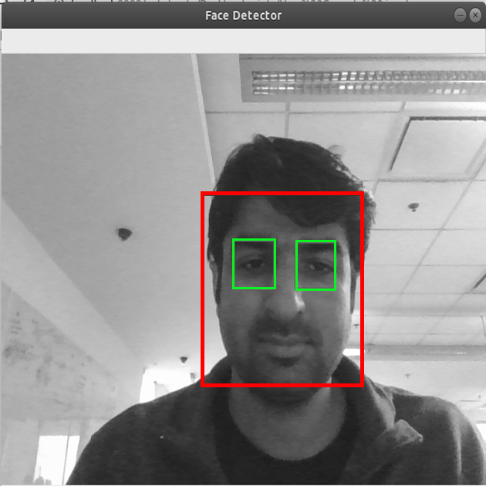
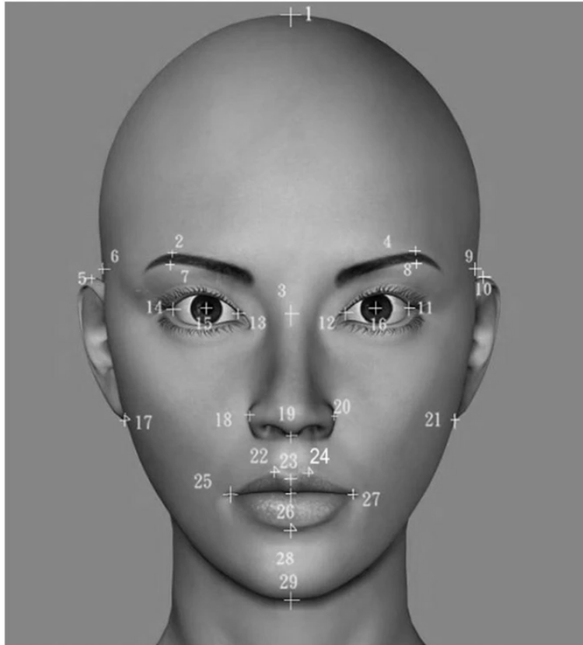
Module Description
Sample Output :
Sample Image of Face Detection
Sample Image of Creating Region of interest
12/04/2021
DATE

Slide 14
Module Description
2) Classification of Image in Classifier
We are using CNN classifier for predicting eye status. To feed our image into the model, we need to perform certain operations because the model needs the correct dimensions to start with.
This can be achieved by extracting the boundary box of the eye and then we can pull out the eye image from the frame with this code.
12/04/2021
DATE

Slide 15
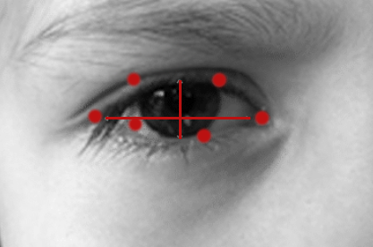
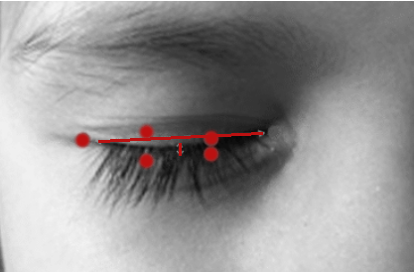
Module Description
Screenshot :
Sample Image of Eye Opened
Sample Image of Eye Closed
12/04/2021
DATE

Slide 16
Module Description
3) Calculation of score count
The score is basically a value we will use to determine how long the person has closed his eyes.
So if both eyes are closed, we will keep on increasing the score and when eyes are open, we decrease the score.
12/04/2021
DATE

Slide 17
Module Description
4) Alarm System Activation
A threshold is defined for example if the score becomes greater than 15 that means the person’s eyes are closed for a long period. This is when we beep the alarm.
If the alarm system continues to activate more than 3 times, the parking light of the vehicle will be turned ON which will reduce the 50 percent of the accident.
On the other hand, this drowsiness message will be shared with the registered mobile number via SMS and Phone call.
12/04/2021
DATE

Slide 18
Sample Code
import face_recognition
import cv2
import numpy as np
import time
import cv2
import eye_game
import RPi.GPIO as GPIO
GPIO.setmode(GPIO.BCM)
GPIO.setwarnings(False)
BUZZER= 23
GPIO.setup(BUZZER, GPIO.OUT)
previous ="Unknown"
count=0
video_capture = cv2.VideoCapture(0)
frame = (video_capture, file)
file = 'image_data/image.jpg'
12/04/2021
DATE

Slide 19
Sample Code
img_image = face_recognition.load_image_file("img.jpg")
img_face_encoding = face_recognition.face_encodings(img_image)[0]
# Create arrays of known face encodings and their names
known_face_encodings = [
img_face_encoding
]
known_face_names = [
"Ashish"
]
# Initialize some variables
face_locations = []
face_encodings = []
face_names = []
process_this_frame = True
while True:
# Grab a single frame of video
ret, frame = video_capture.read()
# Resize frame of video to 1/4 size for faster face recognition processing
12/04/2021
DATE

Slide 20
Sample Code
small_frame = cv2.resize(frame, (0, 0), fx=0.25, fy=0.25)
# Convert the image from BGR color (which OpenCV uses) to RGB color (which face_recognition uses)
rgb_small_frame = small_frame[:, :, ::-1]
# Only process every other frame of video to save time
if process_this_frame:
# Find all the faces and face encodings in the current frame of video
face_locations = face_recognition.face_locations(rgb_small_frame)
face_encodings = face_recognition.face_encodings(rgb_small_frame, face_locations)
cv2.imwrite(file, small_frame)
face_names = []
for face_encoding in face_encodings:
# See if the face is a match for the known face(s)
matches = face_recognition.compare_faces(known_face_encodings, face_encoding)
name = "Unknown"
face_distances = face_recognition.face_distance(known_face_encodings, face_encoding)
12/04/2021
DATE

Slide 21
Sample Code
name = "Unknown"
face_distances = face_recognition.face_distance(known_face_encodings, face_encoding)
best_match_index = np.argmin(face_distances)
if matches[best_match_index]:
name = known_face_names[best_match_index]
direction= eye_game.get_eyeball_direction(file)
print(direction)
#eye_game.api.get_eyeball_direction(cv_image_array)
if previous != direction:
previous=direction
else:
print("old same")
count=1+count
print(count)
if (count>=10):
GPIO.output(BUZZER, GPIO.HIGH)
12/04/2021
DATE

Slide 22
Sample Code
time.sleep(2)
GPIO.output(BUZZER, GPIO.LOW)
print("Alert!! Alert!! Driver Drowsiness Detected")
cv2.putText(frame, "DROWSINESS ALERT!", (10, 30),
cv2.FONT_HERSHEY_SIMPLEX, 0.7, (0, 0, 255), 2)
face_names.append(name)
process_this_frame = not process_this_frame
# Display the results
for (top, right, bottom, left), name in zip(face_locations, face_names):
# Scale back up face locations since the frame we detected in was scaled to 1/4 size
top *= 4
right *= 4
bottom *= 4
left *= 4
# Draw a box around the face
cv2.rectangle(frame, (left, top), (right, bottom), (0, 255, 0), 2)
12/04/2021
DATE

Slide 23
Sample Code
# Draw a label with a name below the face
cv2.rectangle(frame, (left, bottom - 35), (right, bottom), (0, 0, 255), cv2.FILLED)
font = cv2.FONT_HERSHEY_DUPLEX
cv2.putText(frame, name, (left + 6, bottom - 6), font, 1.0, (0, 0, 255), 1)
#cv2.putText(frame, frame_string, (left + 10, top - 10), font, 1.0, (255, 255, 255), 1)
# Display the resulting image
cv2.imshow('Video', frame)
# Hit 'q' on the keyboard to quit!
if cv2.waitKey(1) & 0xFF == ord('q'):
break
# Release handle to the webcam
video_capture.release()
cv2.destroyAllWindows()
12/04/2021
DATE

Slide 24
Conclusion
Thus our system will detect drowsiness while driving and alert the driver and reduce the accident rate.
Also it will send the information about drowsiness to the registered mobile number via, SMS, Dialing.
This will helps the other drivers to be alert by turning ON the parking light.
Our future work is to implement automated car parking along with the alert system
12/04/2021
DATE

Slide 25
REFERENCES
K.Satish, A.Lalitesh, K. Bhargavi, M.Sishir Prem and Anjali.,’Driver Drowsiness Detection’ in IEEE ,July 28 - 30, 2020, India
Association for Safe International Road Travel (ASIRT) , Road Crash Statistics. http: / / assert. org/ initiatives/ informing- roadusers/road-safety-facts/road-crash-statistics, 2016.
Bangkok Post. ( 2015, October 20) , Thailand's roads second deadliest in world, UN Agency finds. http: / / www. bangkokpost. com/ archive/ Thailand- roads- seconddeadliest-in-world-un-agency-finds/736748, 2016.
C. Yang, C. Wu, C. Chou, T.Yang, “Vehicle Driver's EEG and sitting posture monitoring system”, Proceedings of ITAB 2009, Larnaca, Cyprus, 5-7 November 2009.Kei Igarashi, Kazuya Takeda, Fumitada Itakura, and Huseyin Abut, DSP for In-Vehicle and Mobile Systems, Springer US, 2005.
Kim Hong, Chung, “Electroencephalographic study of drowsiness in simulated driving with sleep deprivation.,” International Journal of Industrial Ergonomics., Volume 35, Issue 4, April 2005, Pages 307-320.
https://www.youtube.com/watch?v=Q23K7G1gJgY
12/04/2021
DATE
DATE

Slide 26
THANK YOU
12/04/2021
DATE
DATE

